Slide 1
Visualization of the dependence of the occurrence of oncological diseases on the level of development of the country due to CO2 emissions
Rystin Asset
Toleutay Aldiyar
Zhakipbayev Almas

Slide 2
Why this is important?
In the current technogenic world, the problem of ecology is closely related to the life of people, specifically with health and the emergence of new diseases. Today we can compare the level of development of countries by such a key indicator as GDP, thereby saying that this is an indirect indicator of a well-functioning manufactory.
However, the excess of some production has been and will continue to be carbon dioxide (CO2) pollution, which is a carcinogen that can cause cancer.
The relevance of the topic is to identify the appearance of cancer in the future by predicting future CO2 emissions and visualizing them. This visualization will help to prevent the appearance of oncological diseases.

Slide 3

Research hypothesis
H1
E
H2
S
H3
M

Slide 4
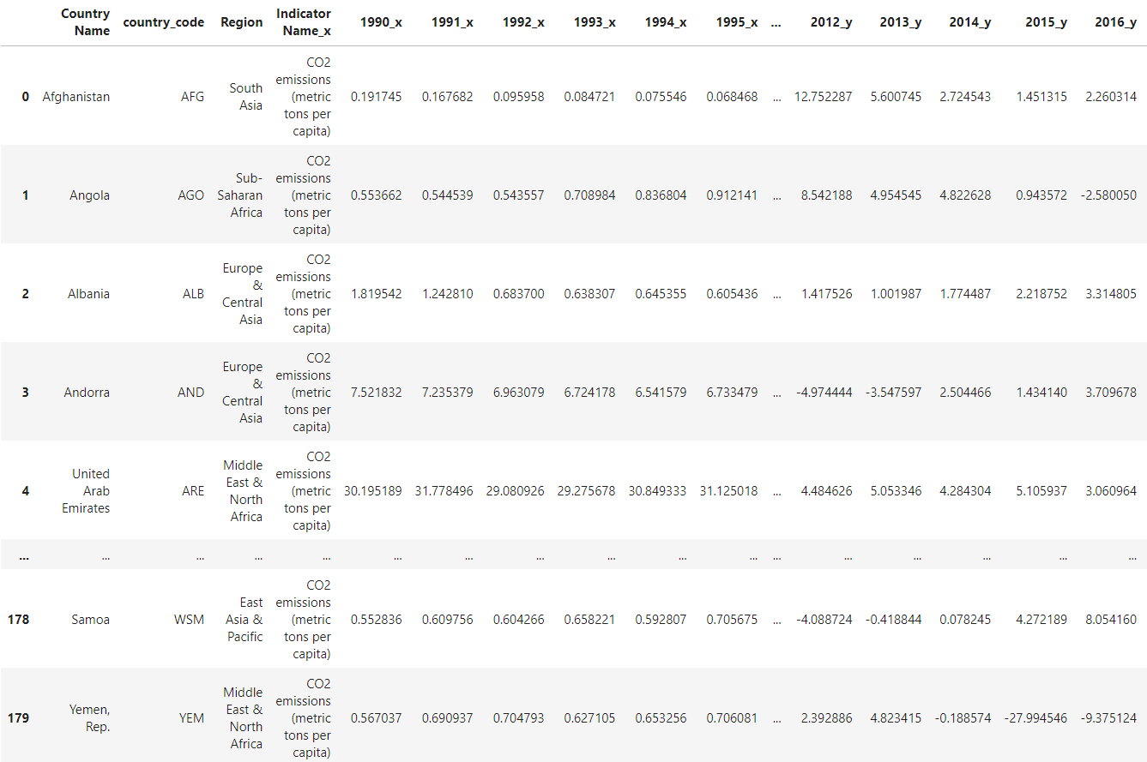
Chosen Datasets

Slide 5
Thank you for your attention!

Slide 8
JANUARY
FEBRUARY
MARCH
APRIL
MAY
JUNE
PHASE 1
Task 1
Task 2
PHASE 2
Task 1
Task 2
JANUARY
FEBRUARY
MARCH
APRIL
PHASE 1
Task 1
Task 2

Slide 11
...and our sets of editable icons
You can resize these icons without losing quality.
You can change the stroke and fill color; just select the icon and click on the paint bucket/pen.
In Google Slides, you can also use Flaticon’s extension, allowing you to customize and add even more icons.

Slide 12
Educational Icons
Medical Icons

Slide 13
Business Icons
Teamwork Icons

Slide 14
Help & Support Icons
Avatar Icons

Slide 15
Creative Process Icons
Performing Arts Icons

Slide 16
Nature Icons

Slide 17
SEO & Marketing Icons

Slide 18


